Slide 1
Lesson objective
Title: DMP/A fluency
Aim:
Be able to simplify after expanding multiple brackets
Plan:
Daily review
Skills practice

Slide 2
The Distributive Property of Multiplication over Addition.
a(b + c) = a$×$b + a$×$c
The term outside the brackets multiplies to EVERY term inside the brackets.
$$4\left(2x+3\right)$$
$$=4 ×2x$$
$$=8x+12$$
$$+4 ×3$$

Slide 3
2(x – 9 )
7(3 – 2x)
5(3x – 3 )
7s(7 – 8s)

Slide 4
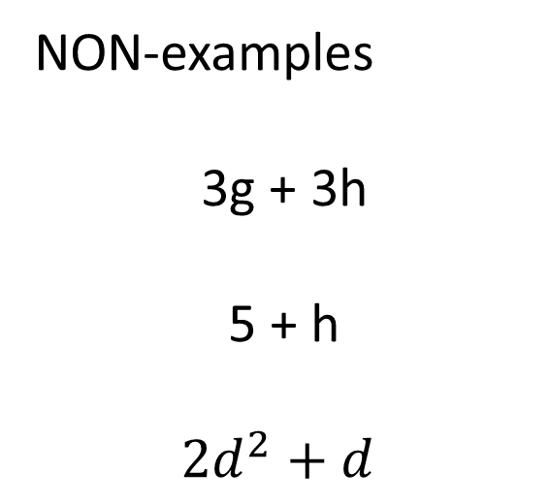
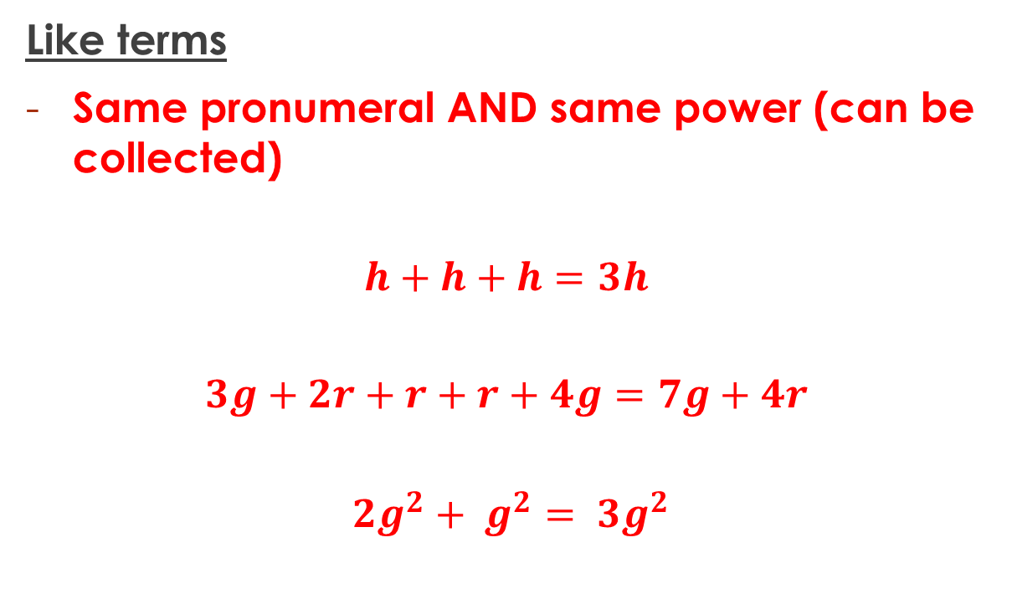
Terminology
Like terms
Same pronumeral AND same power (can be collected)
$$h+h+h=3h$$
$$3g+2r+r+r+4g=7g+4r$$
$${2g}^{2}+ g^{2}= {3g}^{2}$$
NON-examples
3g + 3h
5 + h
$${2d}^{2}+d$$

Slide 5
Skills practice
Complete the activity provided.

